Slide 1
DEFLECTION OF BEAMS
By Dr. Andoh

Slide 2
Introduction
Learning objectives
This unit discusses the various methods used to determine the deflection of beams, which include the strain energy method, the method of calculus and the Macaulay’s method
After reading this unit you should be able to:
Define deflection of a beam
Derive the various equations used to determine the deflection of beams
Select the appropriate boundary conditions for each type of situation
Determine the deflection of beam using the three methods

Slide 3
Differential Equation of the Deflection Curve
Whenever a cantilever or a beam is loaded, it deflects from its original position.
The amount, by which a beam deflects, depends upon its cross-section and the bending moment.
In modern design offices, the two design criteria for the deflection of a cantilever or a beam are strength and stiffness.
As per the strength criterion of the beam design, it should be strong enough to resist bending moment and shear force. Or in other words, the beam should be strong enough to resist the bending stresses and shear stresses.
As per the stiffness criterion of the beam design, which is equally important, it should be stiff enough to resist the deflection of the beam. Or in other words, the beam should be stiff enough not to deflect more than the permissible limit under the action of the loading.
In actual practice, some specifications are always laid to limit the maximum deflection of a cantilever or a beam to a small fraction of its span.

Slide 4
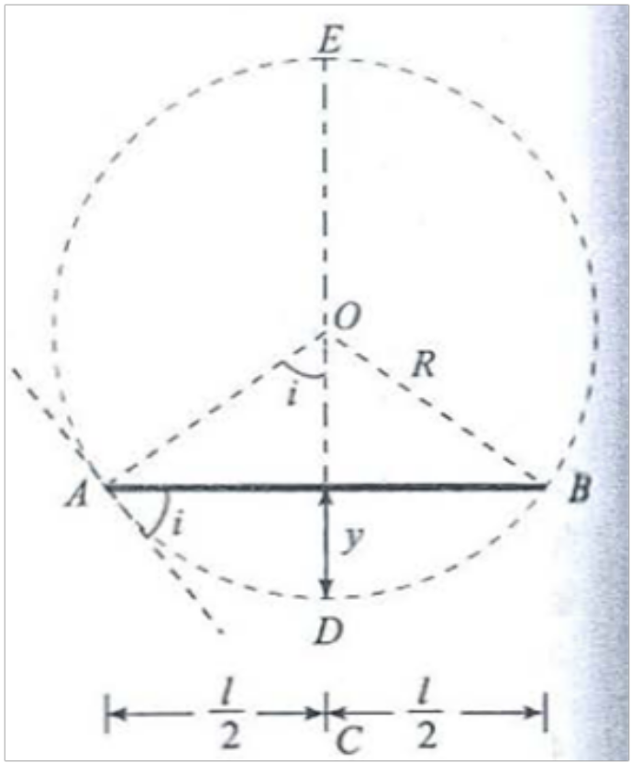
Curvature of the Bending Beam
Consider a beam AB subjected to a bending moment. As a result of loading, let the beam deflects from ABC to ADB into a circular arc as shown in Fig. 1
Let
l Length of the beam AB
M Bending moment,
R Radius of curvature of the bent up beam,
I Moment of inertia of the beam section,
E Modulus of elasticity of beam material,
Y Deflection of the beam (i.e., CD) and
I Slope of the beam (i.e angle which the tangent at A makes with AB)
Fig. 1: : Curvature of the beam

Slide 5


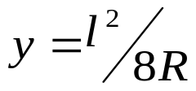
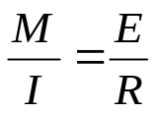

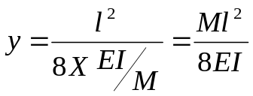
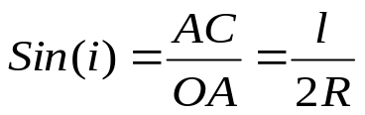
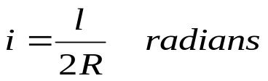
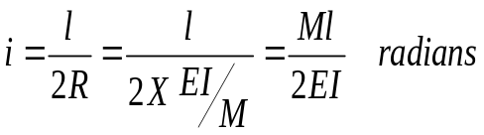
From the geometry of a circle, we know that
Therefore
Neglecting y², ……………………………………………………(i)
From ME 255, for a loaded beam, or
Now substituting this value of R in equation (i),
From the geometry of the figure, we find that the slope of the beam i at A or B is also equal to angle AOC.
Therefore,
Since the angle i is very small. therefore, sin i may be taken equal to i (in radians).
Therefore, ……………………………………………..(ii)
Again substituting the value of R in equation (ii), …(iii)

Slide 6
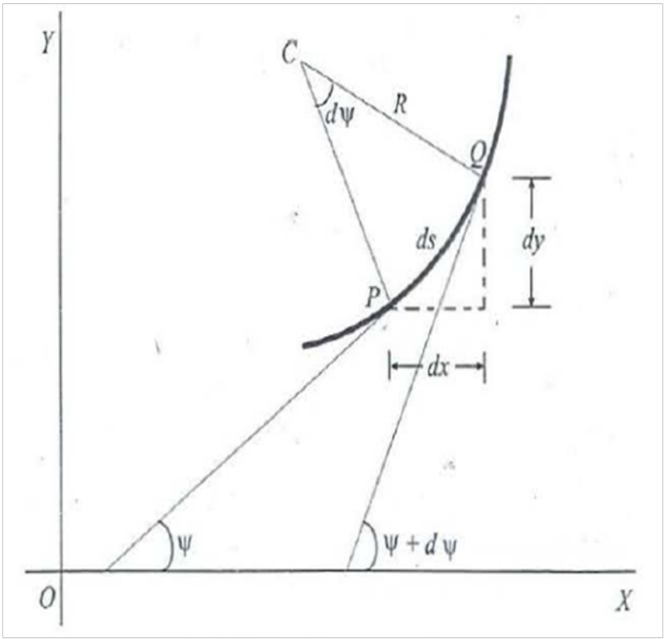
Relationship between Slope, Deflection and Radius of Curvature
Consider a small portion PQ of a beam, bent into an arc as shown in Fig. 2.
Let
ds ,Length of the beam PQ,
R ,Radius of the arc, into which the beam bas been bent,
C ,Centre of the arc,
Ψ ,Angle, which the tangent at P makes with x-x axis and
Ψ+dΨ,Angle which the tangent at Q makes with x-x axis.
Fig. 2, Beam bent into an arc

Slide 7
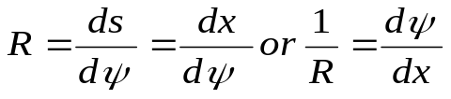
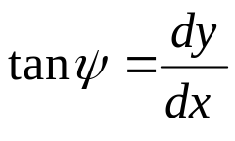

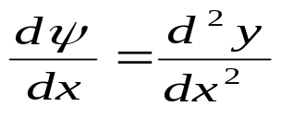
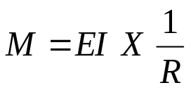
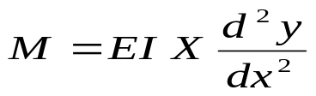
From the geometry of the figure, we find that
Therefore, (Considering ds = dx)
We know that if x and y be the co-ordinates of point P, then
Since 'Ψ' is a very small angle, therefore taking
Therefore,
We also know that or
Therefore,
NOTE: The above equation is also based only on the bending moment. The effect of shear force, being very small as compared to the bending moment, is neglected.
Self Assessment
What is deflection of beams and state the relation between deflection and bending moment.

Slide 8
Methods for Slope and Deflection at a Section
Strain Energy Method (Castigliano’s Theorem)
Double Integration Method
Singularity Function (Macaulay's Method)

Slide 9




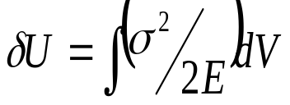
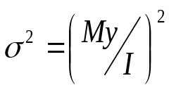
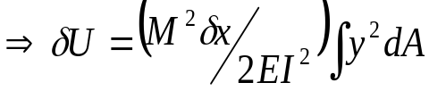

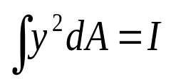
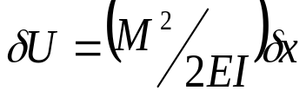

Strain Energy Method
Consider a short length of beam ,under the action of a bending moment M. If is the bending stress on an element of the cross-section of area at a distance y from the neutral axis, the strain energy of the length is
given by
But and
But hence
For the whole beam:
The product EI is called the Flexural Rigidity of the beam.

Slide 10
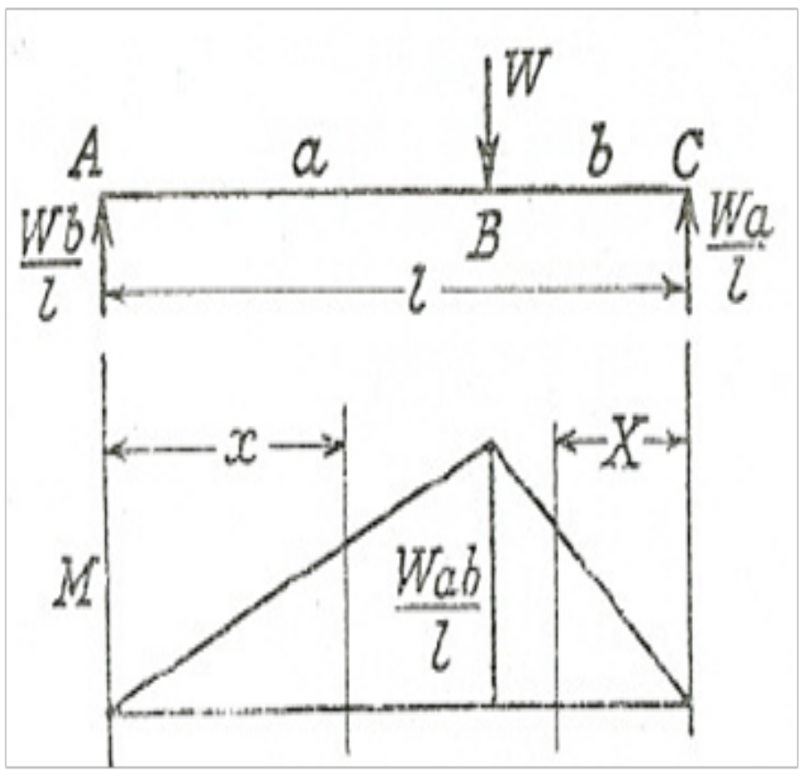
Example 1-1: A simply supported beam of length I carries a concentrated load W at distances of a and b from the two ends. Find expressions for the total strain energy of the beam and the deflection under the load.
Fig. 3: Diagram for example 1

Slide 11

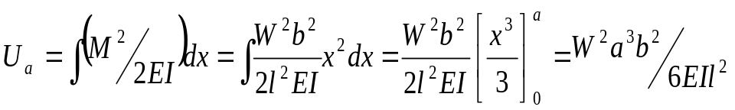
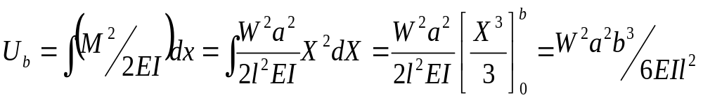
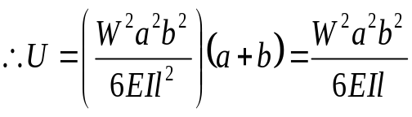


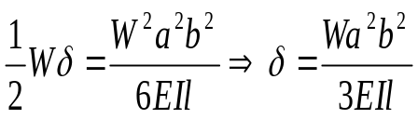
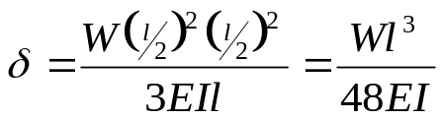
Solution
The integration for strain energy can only be applied over a length of beam for which a continuous expression for M can be obtained. This usually implies a separate integration for each section between two concentrated loads or reactions.
Referring to Figure 3, for the section AB,
Similarly, by taking a variable X measured from C
The total strain energy is
But, if is the deflection under the load, the strain energy must equal the work done by the load (gradually applied),
i.e.
For a central load, a =b =1/2, and
It should be noted that this method of finding deflection is limited to cases where only one concentrated load is applied (i.e. doing work), and then only gives the deflection under the load.

Slide 12
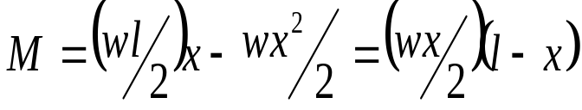
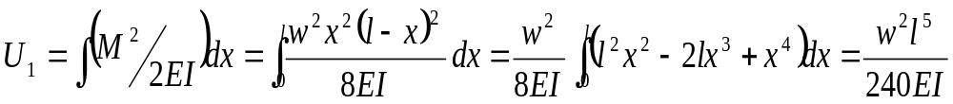
Example 1-2: Compare the strain energy of a beam, simply supported at its ends and loaded with a uniformly distributed load, with that of the same beam centrally loaded and having the same value of maximum bending stress.
Solution
If l is the span and EI the flexural rigidity, then for a uniformly distributed load w, the end reactions are wl/2, and at a distance x from one end,

Slide 13
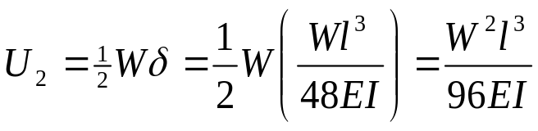
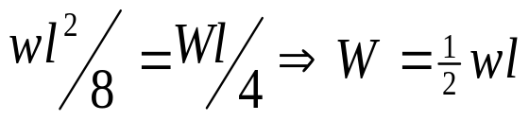
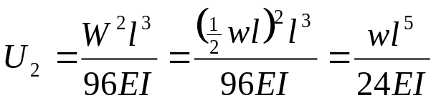
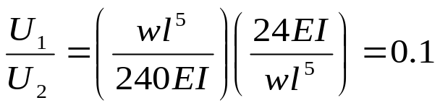
For central load of W, (Example 1-1),
Maximum bending stress=M/Z, and for a given beam depends on the maximum bending moment. Since the section modulus is the same and for the two bending stresses to be the same, then the maximum bending moment must be the same.
Hence equating maximum bending moments, we
have
Hence
Ratio

Slide 14
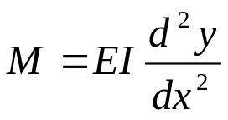
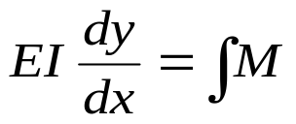
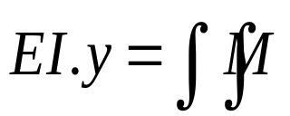
Double Integration Method
Bending moment at a point is given by
First integration of the above equation gives
…………………………………………….(i)
Second integration gives ………..(ii)
It is thus obvious that after first integration of the original differential equation, we get the value of slope at any point. On further integration, we get the value of deflection at any point.

Slide 15
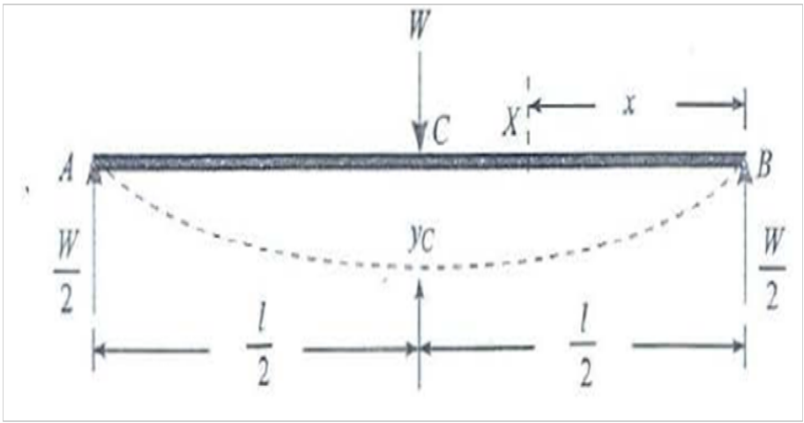
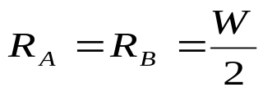
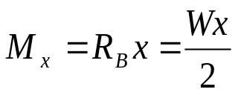
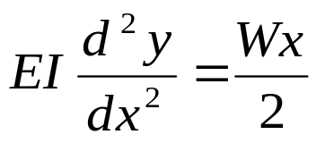
Simply Supported Beam with a Central Point Load
Consider a simply supported beam AB of length l and carrying a point load W at the centre of beam C as shown in Fig. 4. From the geometry of the figure, we find that the
reaction at A,
Consider a section X at a distance x from B. We know that the bending moment at this section,
(Plus sign due to sagging)
Therefore, ……(i)
Fig. 4: Simply supported beam with a central point load

Slide 16
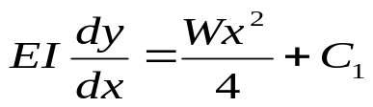
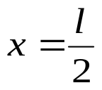
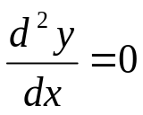
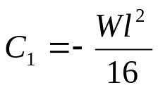
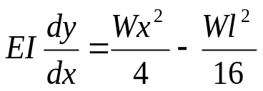
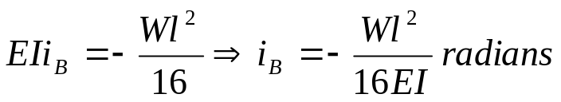
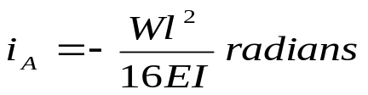
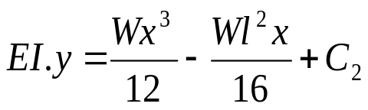
Integrating (i) gives …………………(ii)
where C_{l} is the first constant of integration.
When , then
Substituting these values in equation (ii) gives
Substituting value of C₁ into (ii) gives …….(iii)
This is the required equation for the slope, at any section. It will be interesting to know that the maximum slope occurs at A and B. Thus for maximum slope at B, substituting x = 0 in equation (iii), we
have
By symmetry,
Integrating the equation (iii) once again,
……………………………….(iv)
where C₂ is the second constant of integration.

Slide 17
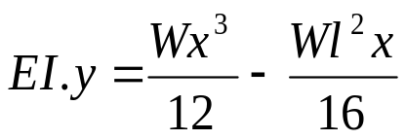
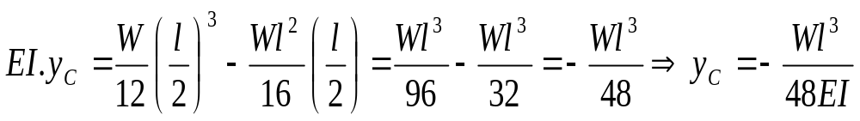
When x = 0, then y = 0, Substituting these values in equation (iv), we get C₂ = 0.
Therefore,
This is the required equation for the deflection, at any section. A little consideration will show that maximum deflection occurs at the mid-point C. Thus for maximum deflection, substituting x = l/2
In equation (v),

Slide 18
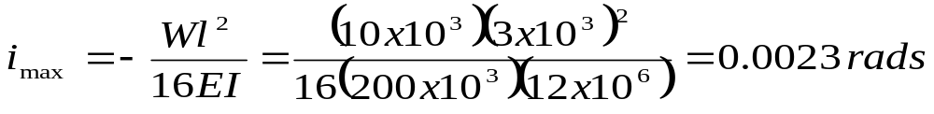
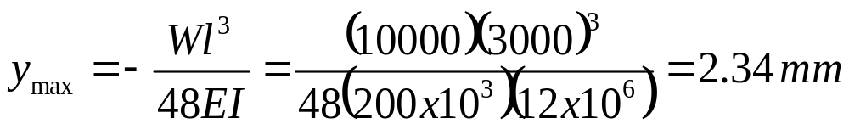
Example 1-3: A simply supported beam of span 3 m is subjected to a central load of 10 kN. Find the maximum slope and deflection of the beam. Take I= 12 X 10⁶ mm⁴ and E = 200 GPa
Solution
Given:
Span (l) = 3 m = 3 x 10³ mm;
Central load (W) = 10 kN = 10 x 10³ N
Moment of inertia (I)= 12 x 10⁶ mm⁴ and
Modulus of elasticity (E)= 200 GPa = 200 x 10³ N/mm²,
Maximum slope of the beam
Maximum deflection of the beam

Slide 19
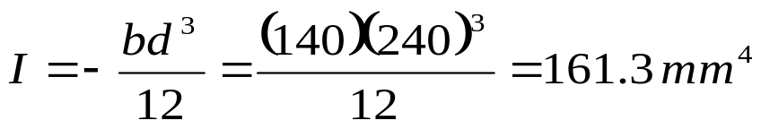

Example 1-4: A wooden beam 140 mm wide and 240 mm deep has a span of 4 m. Determine the load that can be placed at its centre to cause the beam a deflection of 10 mm. Take E = 6GPa.
Solution
Given: Width (b)= 140 mm; Depth (d)= 240 mm ; Span(l)= 4 m = 4 x l 0³ mm
Central deflection <Yc> = 10 mm and
Modulus of elasticity (E)= 6 GPa = 6 x 10³ N/mm²
Let W = Magnitude of the load,
We know that moment of inertia of the beam section,
Deflection of the beam at its centre (y_{c}),

Slide 20

Simply Supported Beam with an Eccentric Point Load

Slide 21



Slide 22


Slide 23



Slide 24


Slide 25


Slide 26


Slide 27



Slide 28

Simply Supported Beam with a Uniformly Distributed Load

Slide 29



Slide 30


Slide 31



Slide 32


Slide 33

Cantilever with a Point Load at Free End

Slide 34



Slide 35


Slide 36


Slide 37

Cantilever with a Point Load not at the Free End

Slide 38


Slide 39

Cantilever with a Uniformly Distributed Load and a Point Load

Slide 40



Slide 41


Slide 42


Slide 43


Slide 44


Cantilever Partially Loaded with a Uniformly Distributed Load

Slide 45


Slide 46


Simply Supported Beam with a Gradually Varying Load

Slide 47


Slide 48



Slide 49


Slide 50

Cantilever with a Gradually Varying Load

Slide 51


Slide 52


Slide 53



Slide 54

Singularity Function
(Macaulay’s Method)

Slide 55

Concentrated Loads

Slide 56


Slide 57

Uniformly Distributed Load

Slide 58



Slide 59

Concentrated Bending Moment

Slide 60


Slide 61


Slide 62


Slide 63



Slide 64


Slide 65


Slide 66


Slide 67


Slide 68
Quizzes
What is the relation between slope, deflection and radius of curvature of a simply supported beam?
A simply supported beam AB of span l and stiffness El carries a concentrated load P at its centre. Find the expression for slope of the beam at the support A and deflection of the beam at its centre.
Derive a relation for the slope and deflection of a simply supported beam subjected to a uniformly distributed load of w/m length.
Explain the procedure for finding out the deflection of a beam of composite section.
A cantilever beam of span l carries a uniformly distributed load w over the entire span. Compute the maximum slope and deflection of a cantilever.

